Slide 1
https://mindmajix.com/react-js-tutorial

Slide 2
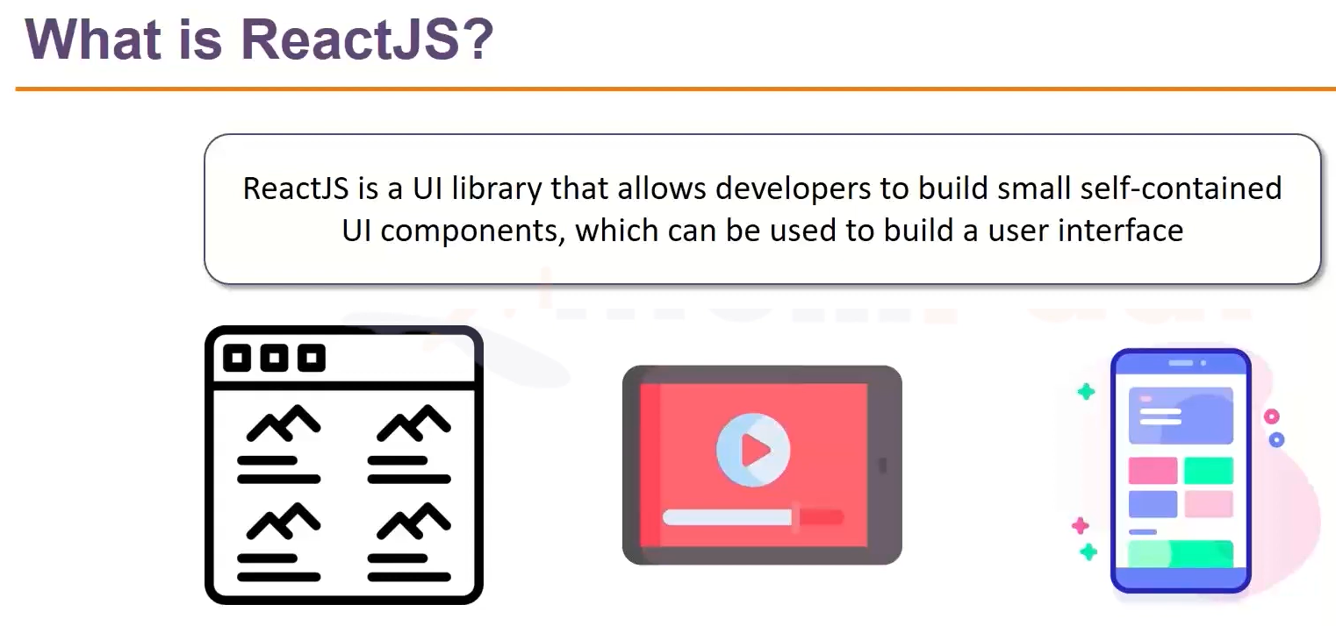

Slide 3
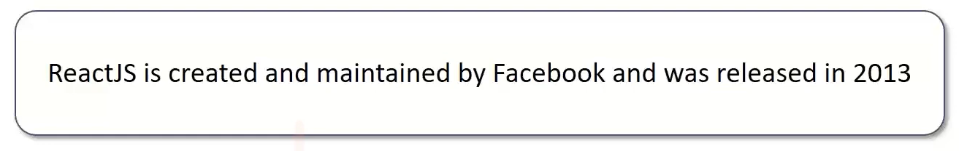

Slide 4
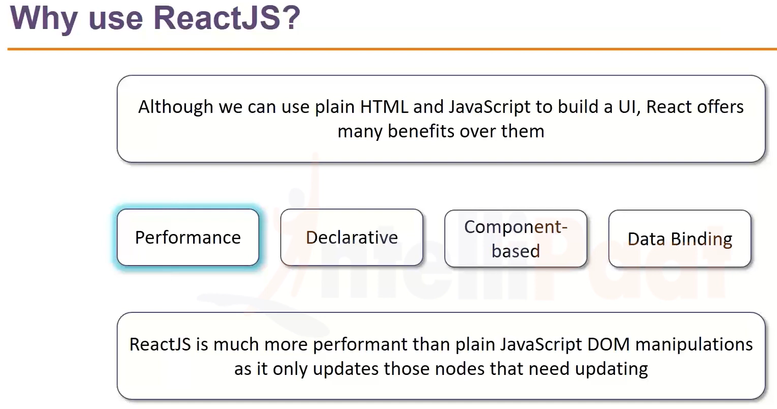

Slide 5
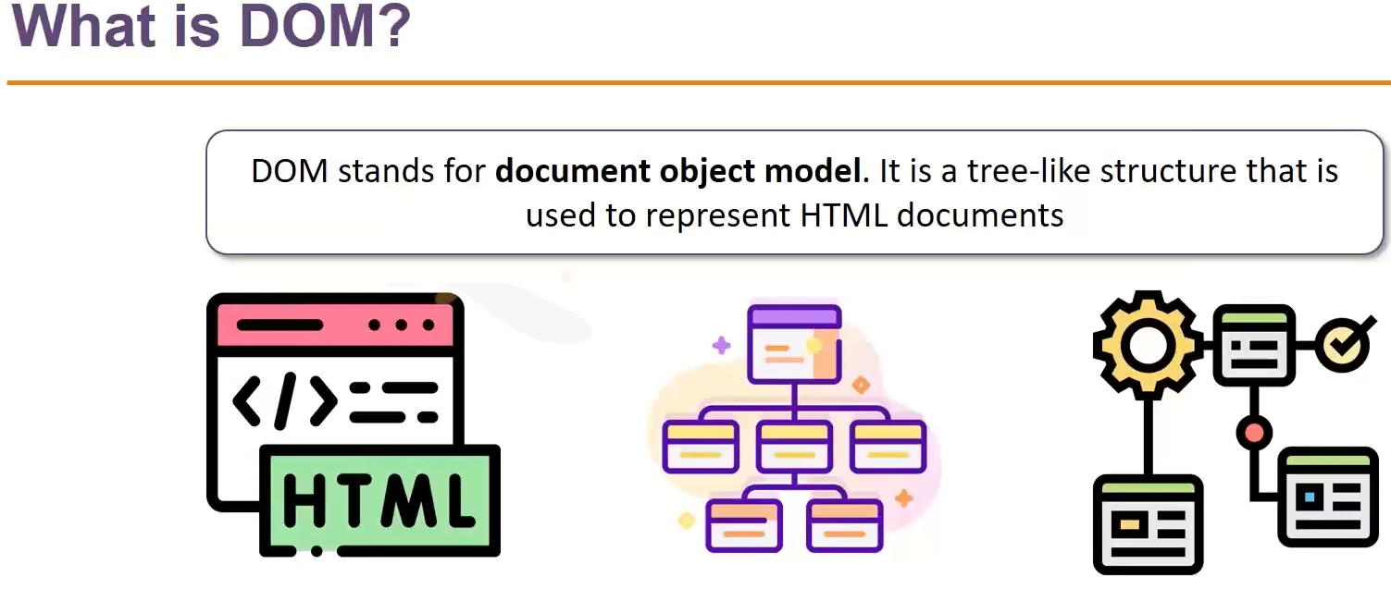
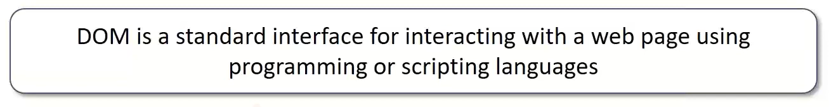

Slide 6
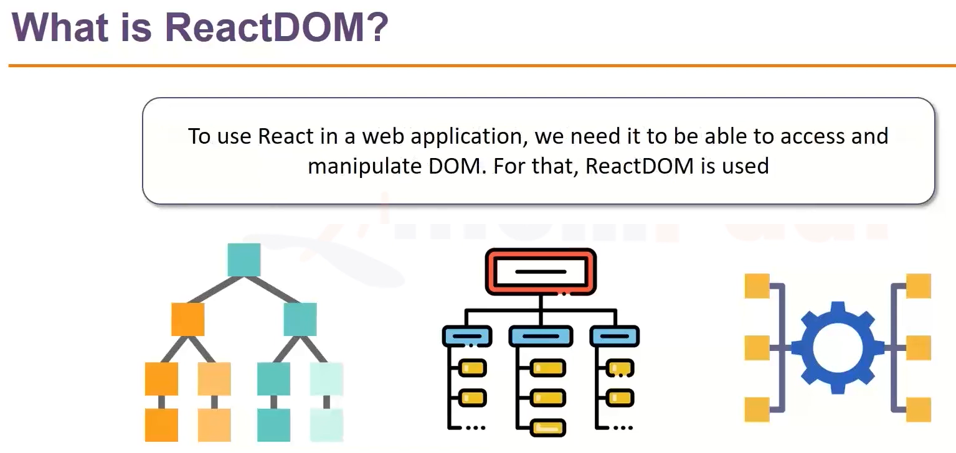

Slide 7
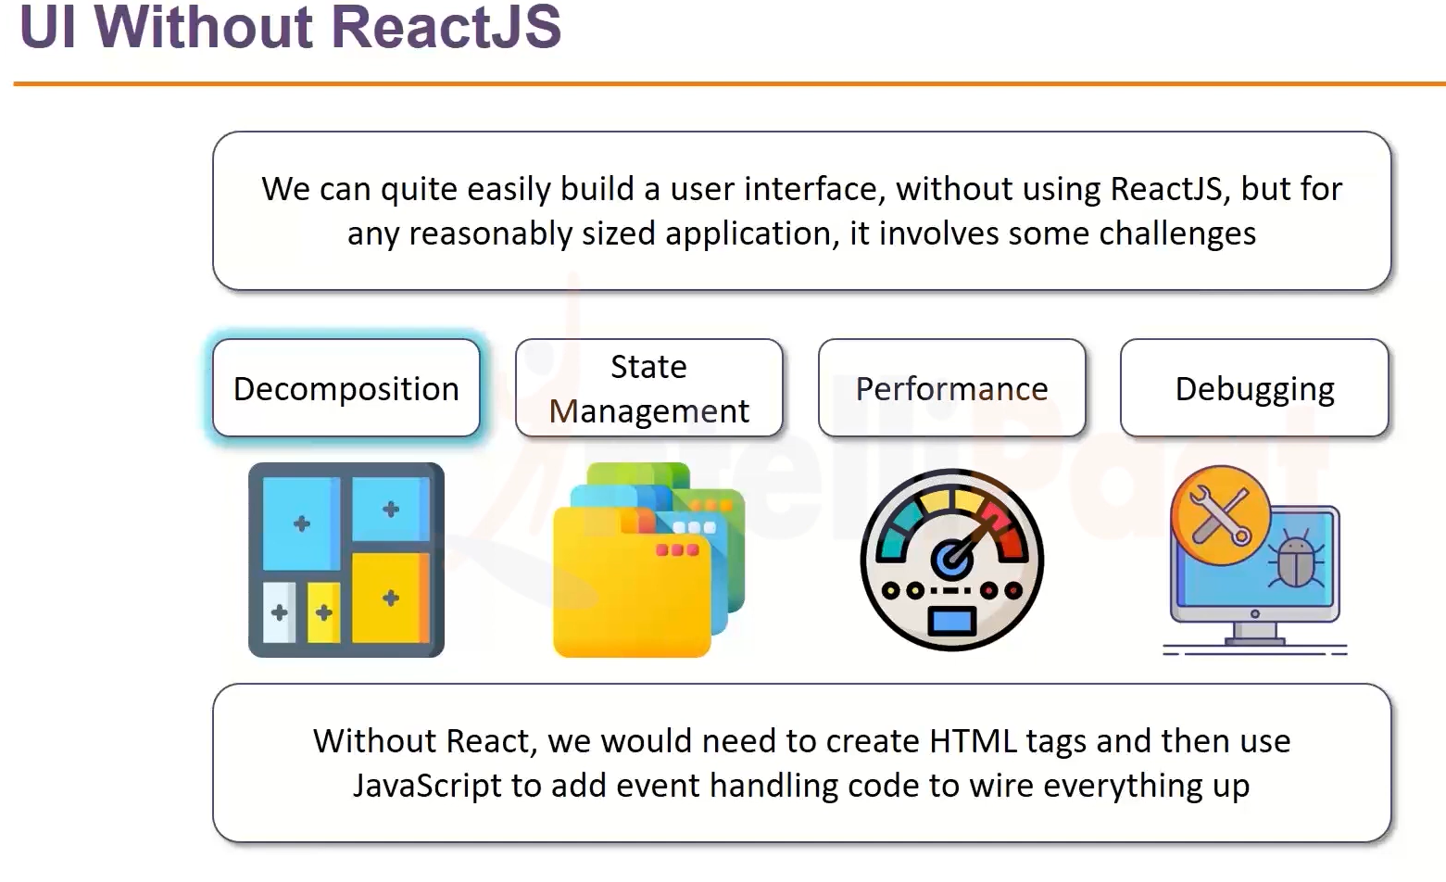

Slide 8
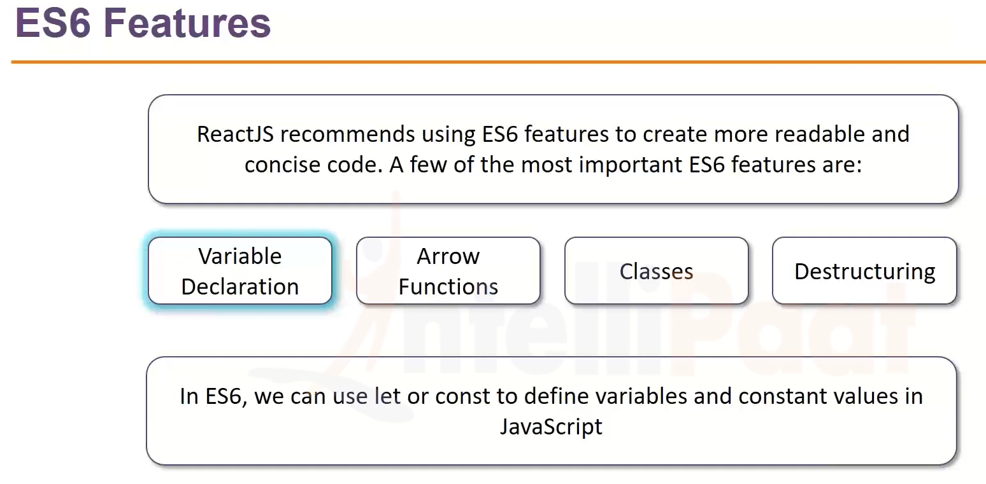

Slide 9
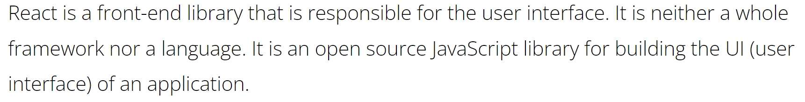

Slide 10
React is a front-end library that is responsible for the user interface.
It is neither a whole framework nor a language. It is an open source JavaScript library for building the UI (user interface) of an application.

Slide 11
Why React
React is declarative, flexible, and easy to learn. React is maintained by Facebook and a community of individual developers. Currently, there is a great demand for React.js in the industry.
React can be used for development of single page applications or mobile applications. For complex applications, React uses additional libraries for state management, routing, and interaction with an API.
React allows us to compose complex UIs by writing a small piece of code. An isolated piece of code is called Component.

Slide 12
Prerequisites of React
You should have knowledge of HTML, CSS, and JavaScript fundamentals.
You should also be aware of ES6.

Slide 13
Folder Structure In React
Creating React applications
In order to create a React application, we will be using the create-react-app node_module
provided by React. This helps us by creating a consistent folder structure automatically
so, that we don’t need to care about proper and valid folder structure.
npx create-react-app ReactDemo

Slide 14
After creating a React application, we will notice that in Terminal, it provides quick tips or commands that will help in executing the React application.
For example -
npm start - This command will start the development server.
npm run build - Bundles the app into static files for production.
npm test - starts the test runner.
npm run object - Removes this tool and copies build dependencies, configuration files, and scripts into the app directory.

Slide 15
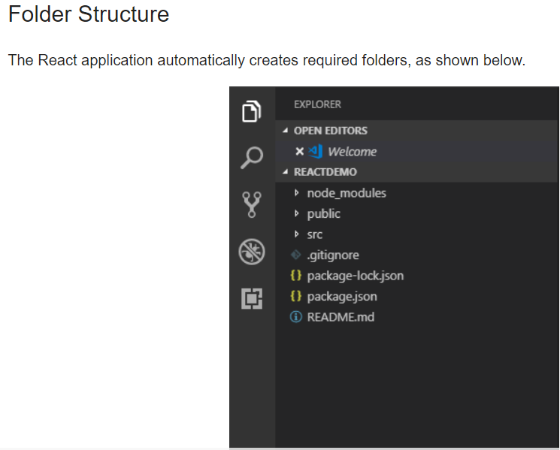

Slide 16
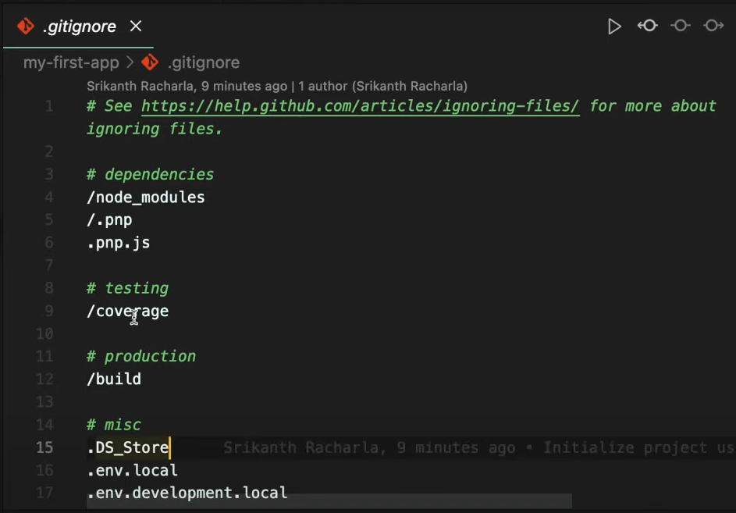

Slide 17
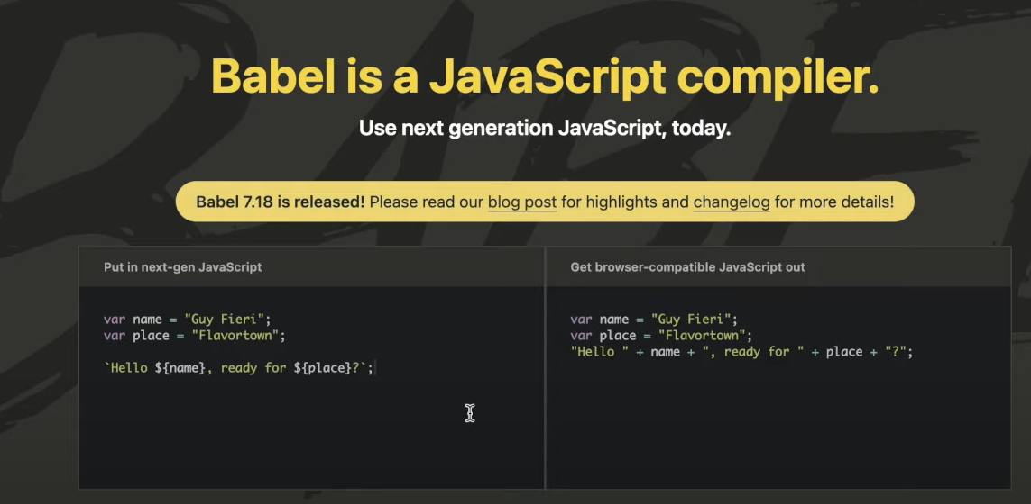

Slide 18
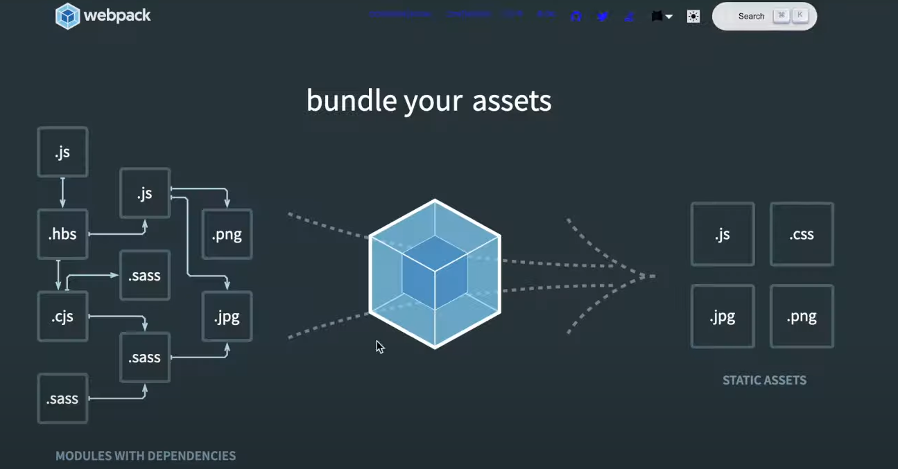

Slide 19
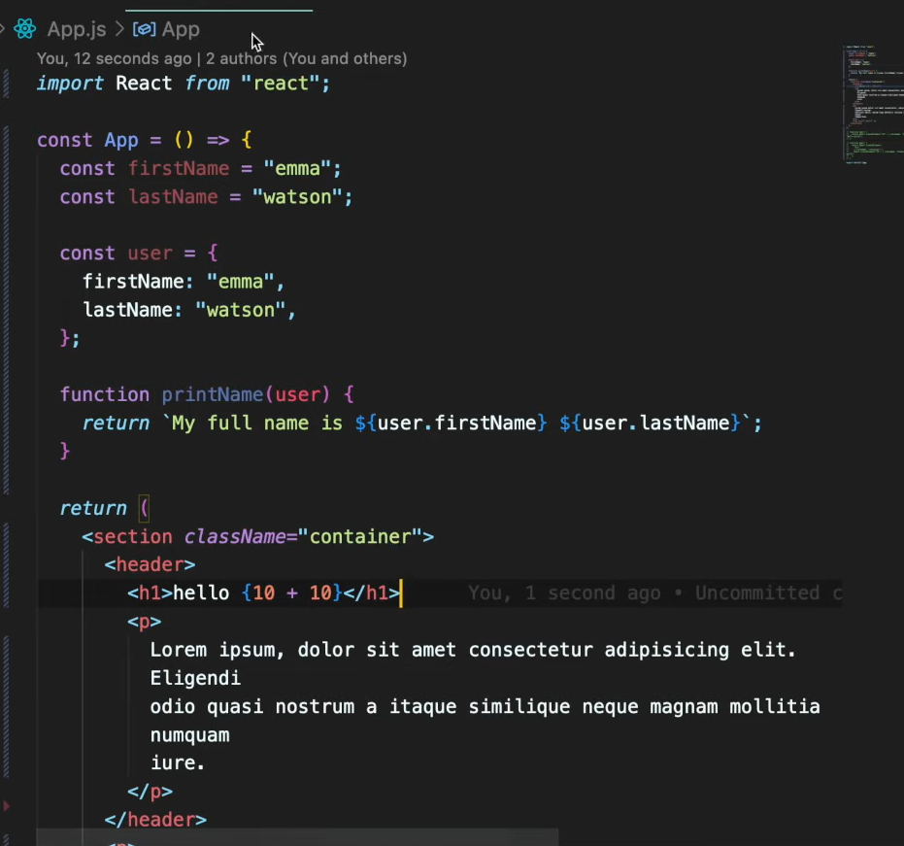

Slide 20
https://www.youtube.com/watch?v=2iN1jSaNsFI&list=PLkusOHO_VvuAtYE2PmWcfcffO7SK7VwUT&index=52

Slide 21
Components In React
In React, a component is referred to as an isolated piece of code which can be reused in one or the other module.
The React application contains a root component in which other subcomponents are included;
for example - in a single page, the application is subdivided into 3 parts - Header, Main Content, and Footer.
So, there is a single App Component having 3 subcomponents - Header Component, MainContent Component, and Footer Component.
There are 2 types of components in React.js
Stateless Functional Component
Stateful Class Component

Slide 22
Stateless Functional Component
This type of component includes simple JavaScript functions. These components include immutable properties, i.e., the value for properties cannot be changed.
We need to use Hooks to achieve functionality for making changes in properties using JS.
A functional component is used mainly for UI.
function Demo(props)
{
return <h1> Hello, {props.Name} </h1>;
}
Components In React (c-sharpcorner.com)

Slide 23
Stateful Class Component
The Class component is ES6 classes which extend the Component class from React library. The class component must include the render method which returns HTML.
class Demo extends React.Component{
render(){
return <h1> Hello, {props.Name} </h1>;
}
}

Slide 24
Important Point
You can use it without exporting/importing class/functional component.
The imported class/function must be in upper case; else it will give an error.
Class/Functional component returning JSX i.e) Javascript XML.

Slide 25
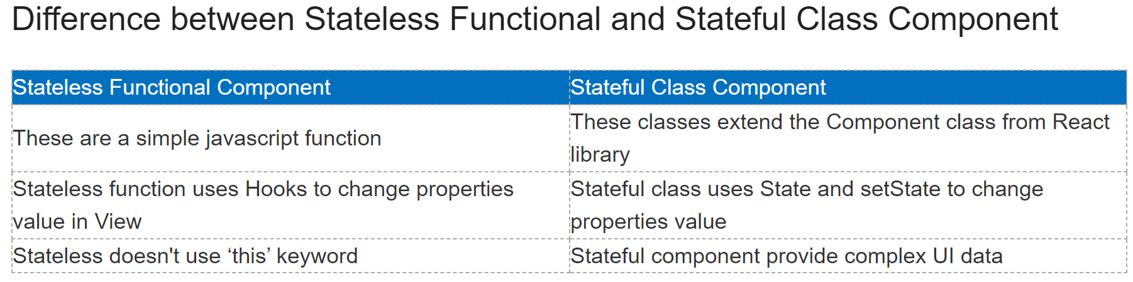

Slide 26
What is JSX?
JSX is a JavaScript XML used in React applications. JSX is not compulsory to use in React applications but it makes your code more readable, reliable, and easy to modify. JSX is an extension to JavaScript.
JSX uses HTML syntax to create elements and components. It is just like a templating syntax. It has the tag name, attributes, and children. JSX compiles the code into pure JavaScript which can be understood by the browser.
https://github.com/racharlasrikanth/react-full-course

Slide 27
React JSX And Hooks (c-sharpcorner.com)
https://dotnettutorials.net/course/reactjs-tutorials/
https://www.guru99.com/reactjs-tutorial.html
https://www.tutorialspoint.com/reactjs/reactjs_introduction.htm
https://www.simplilearn.com/tutorials/reactjs-tutorial/reactjs-state
https://www.geeksforgeeks.org/react-tutorial/
https://www.pragimtech.com/blog/reactjs/reactjs-introduction/

Slide 28
React - Redux
https://medium.com/swlh/what-is-redux-b16b42b33820
https://www.memberstack.com/blog/react-redux

Slide 29
At a high level, redux is a global state management library for JavaScript apps.
React Redux will offer us a central store to hold all the React application states.
It has an API so any component at any level of the app can access and update the state at any time.

Slide 30
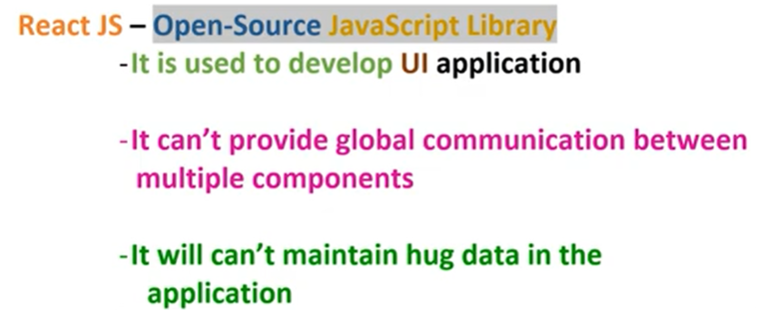

Slide 31
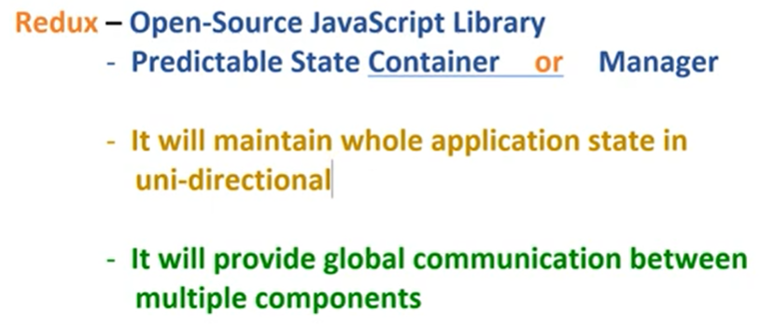

Slide 32
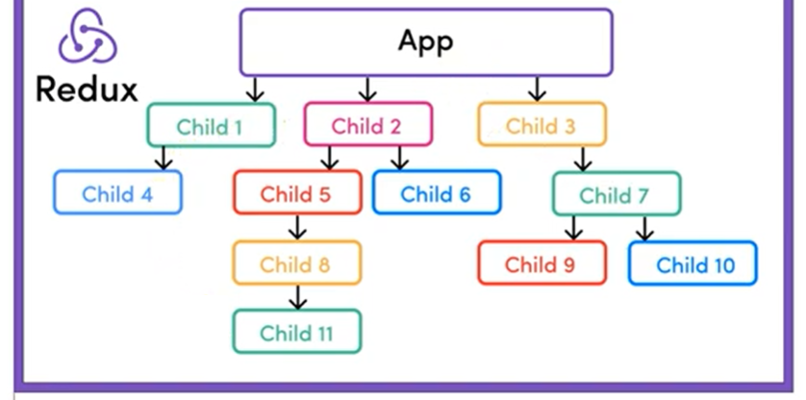

Slide 33
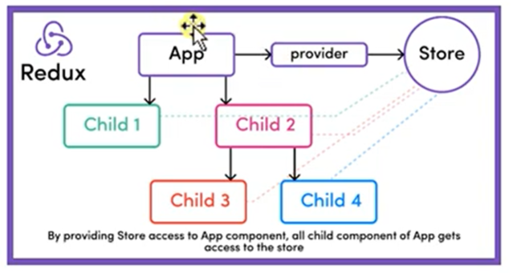

Slide 34
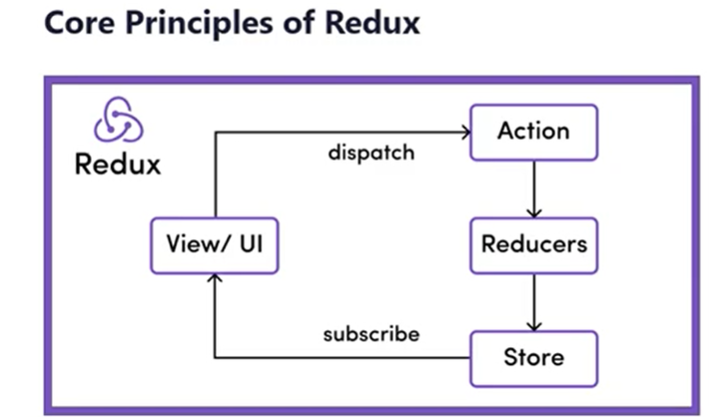

Slide 35
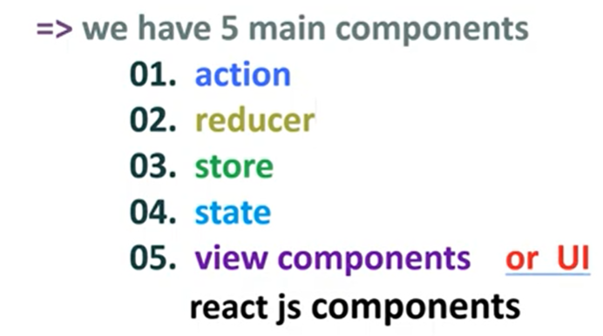

Slide 36
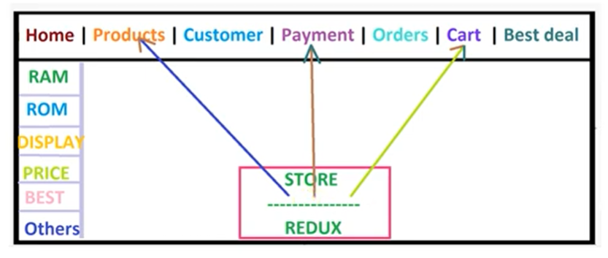

Slide 37
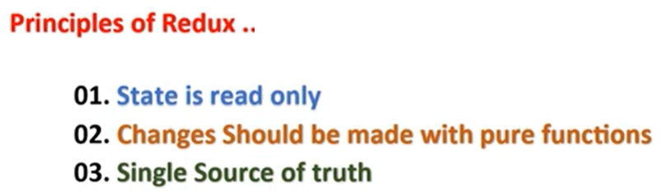
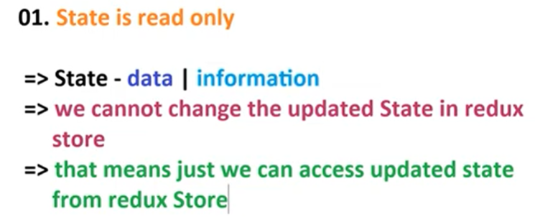

Slide 38
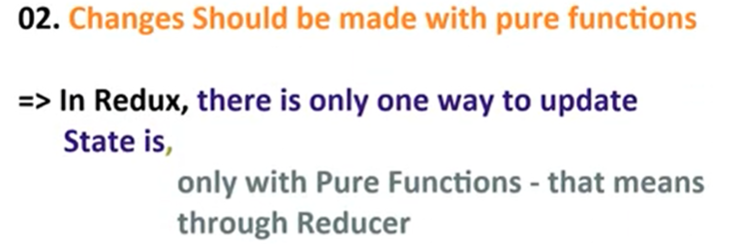
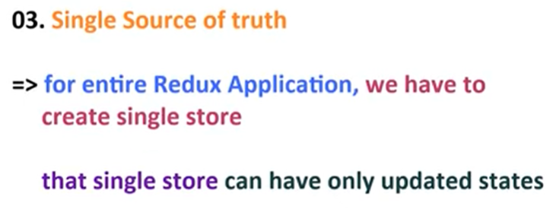

Slide 39
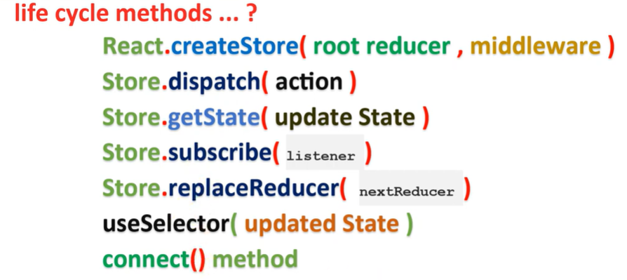

Slide 40
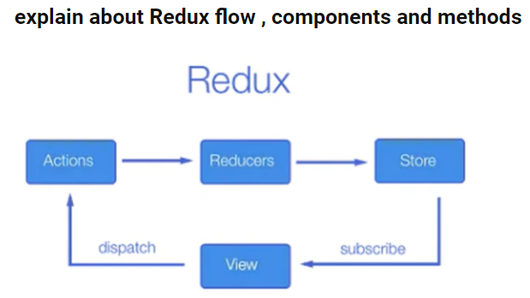

Slide 41

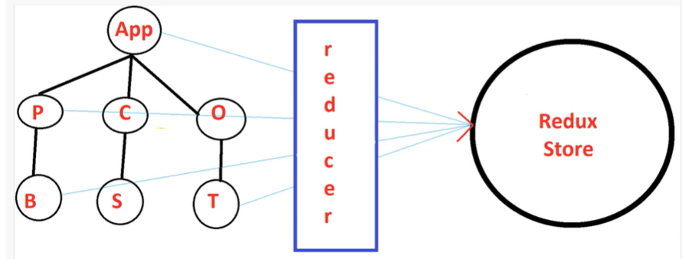

Slide 42
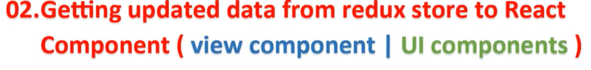
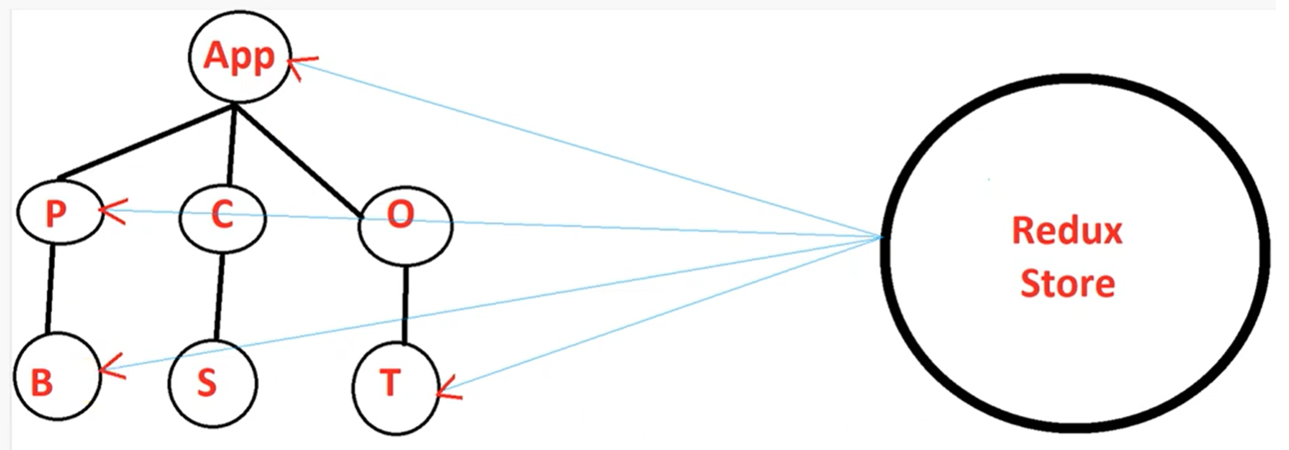

Slide 43
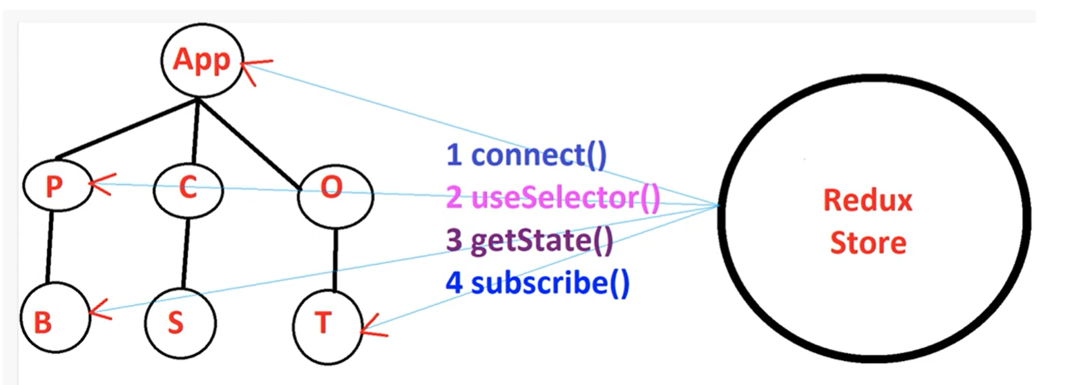

Slide 44
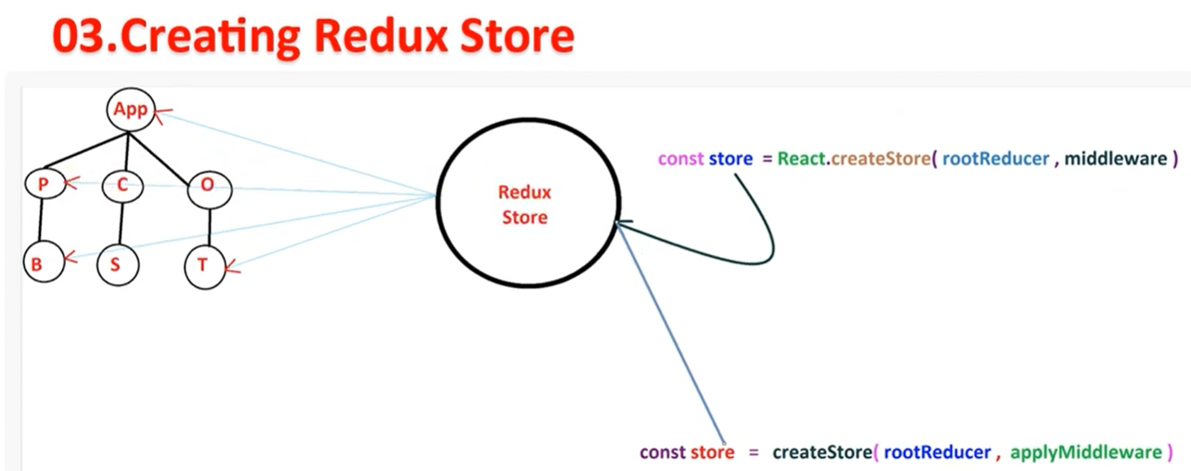

Slide 45
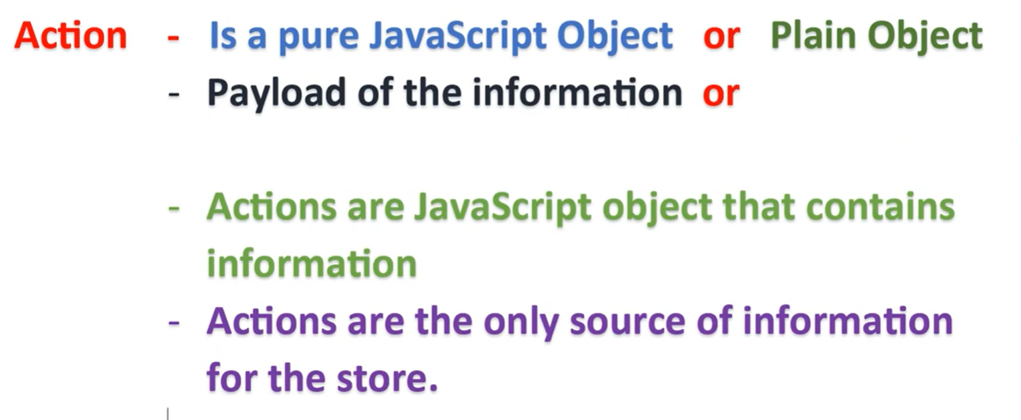
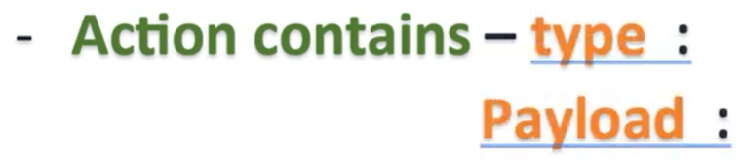

Slide 46
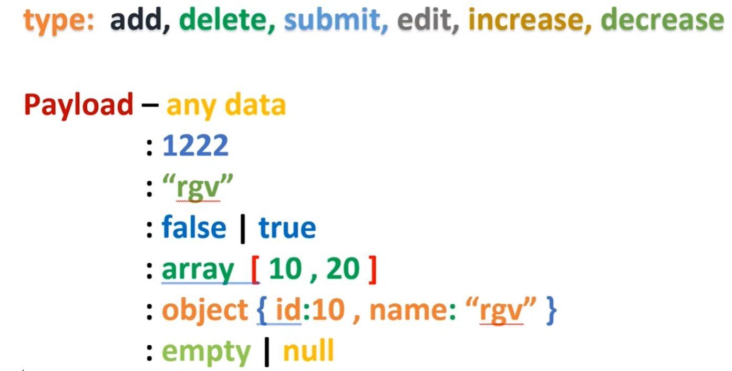

Slide 47
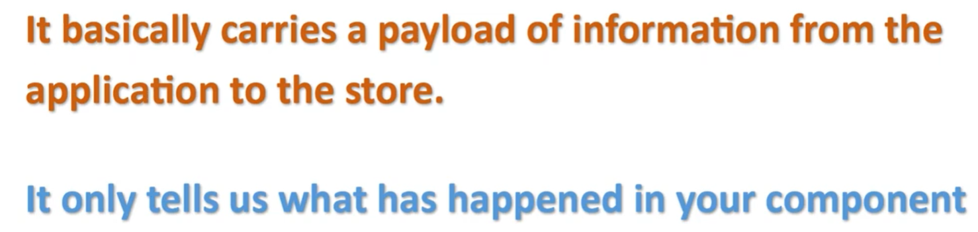
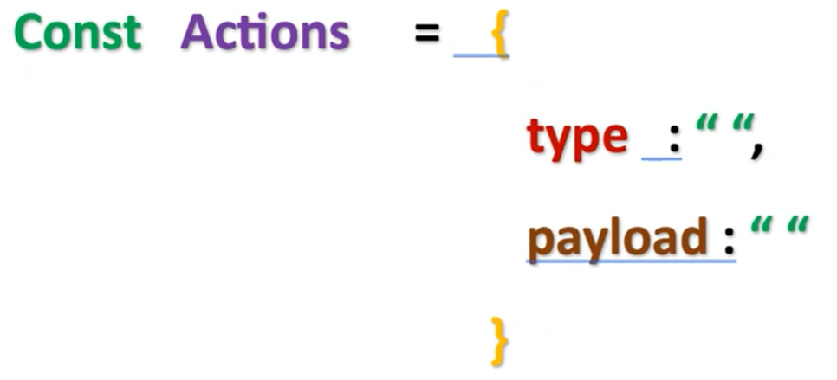

Slide 48

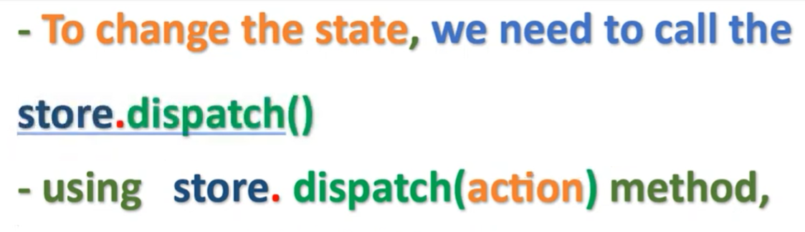

Slide 49
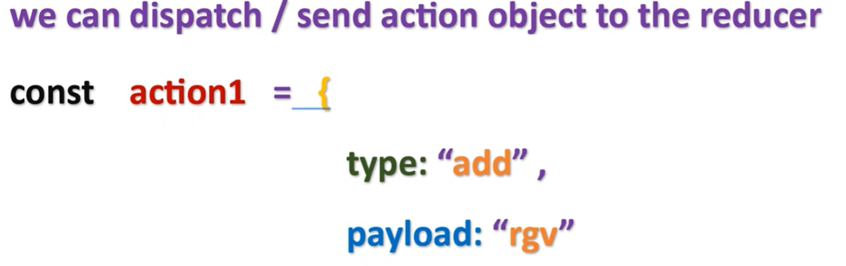

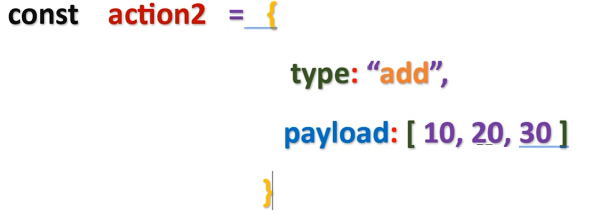

Slide 50
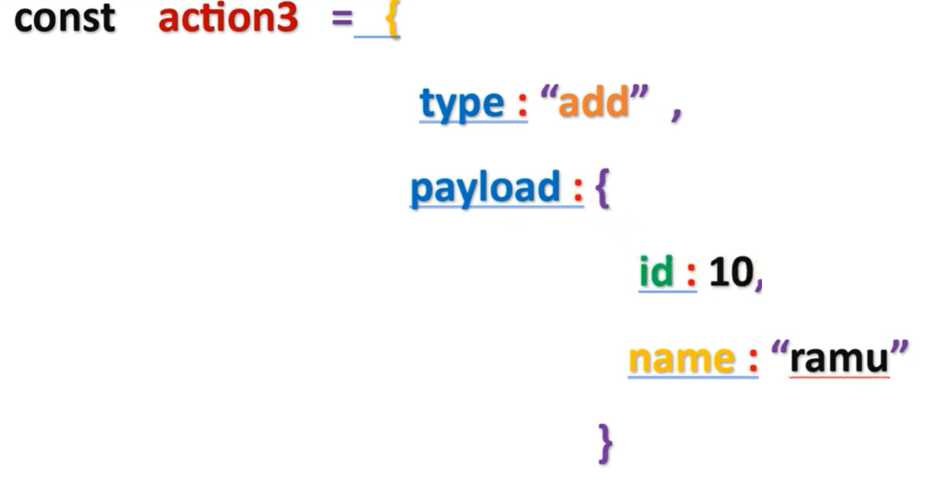

Slide 51
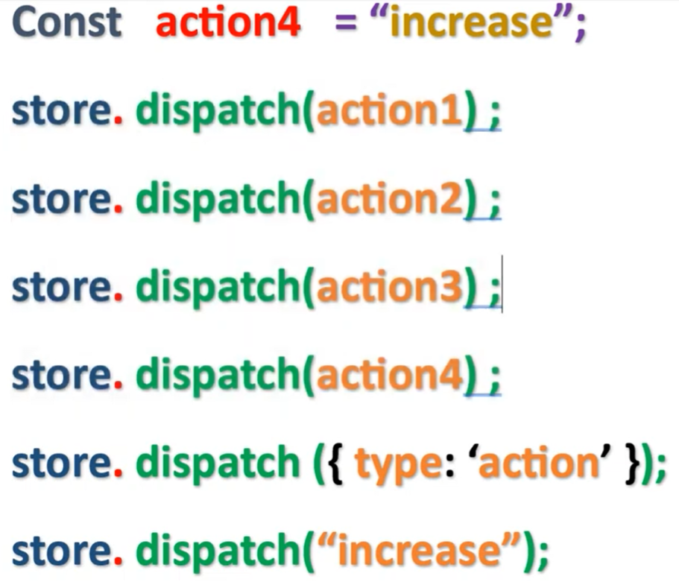

Slide 52
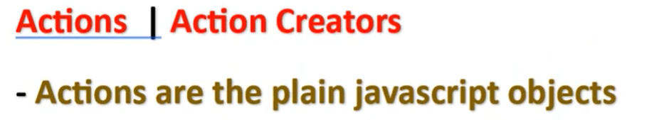


Slide 53
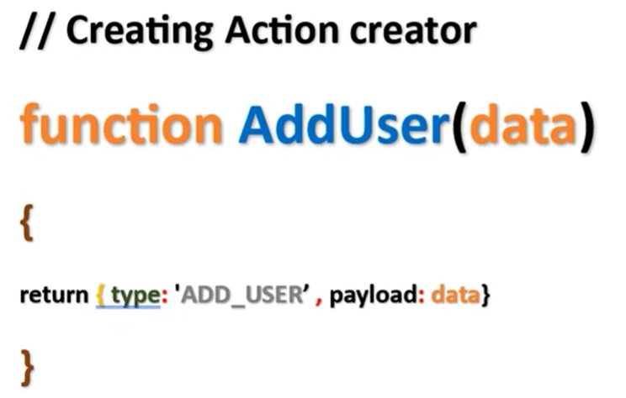

Slide 54
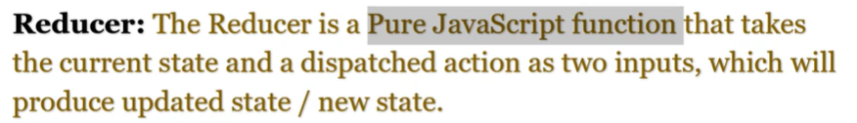
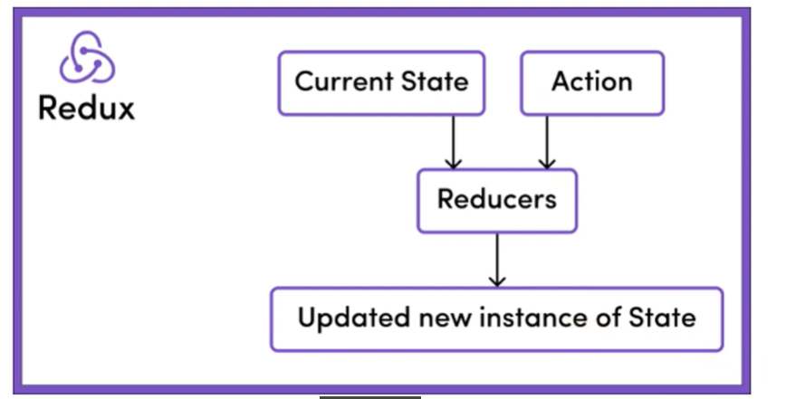

Slide 55
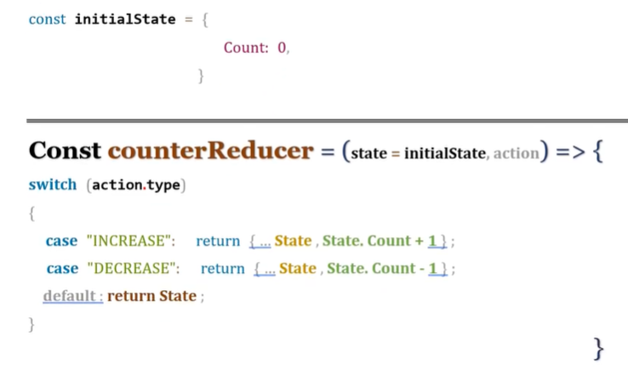


Slide 56
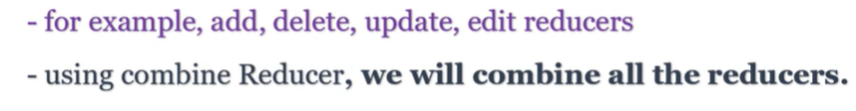
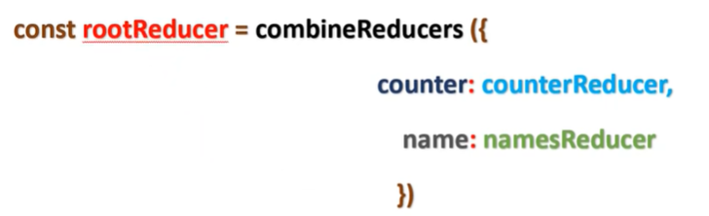

Slide 57



Slide 58


Slide 59



Slide 60


Slide 61



Slide 62



Slide 64


Slide 65


Slide 66


Slide 68


Slide 69



Slide 70




Slide 71



Slide 72
https://www.youtube.com/watch?v=xnAWeJ1npBk&list=PLNRAO669WN3IrpGdG8XcGYdRrA1PZwGB0&index=14

